Slide 1
Dream-Cart
eCommerce | Group_20
TA: Devanshi Chandegra

Slide 2
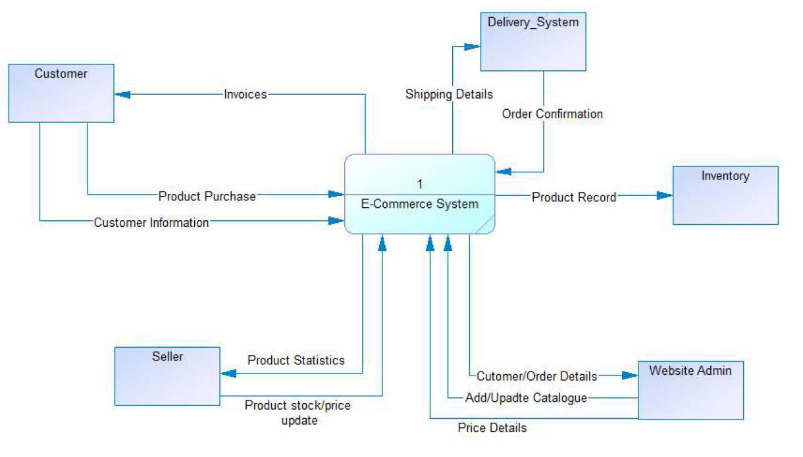
Context Diagram

Slide 3
Functional Summary
View-Only mode: Users surfing through the website without logging in are using the view-only method of the website. This will help increase the website traffic since many users hesitate to sign-up.
Type-of-users: Dream-Kart bifurcates users into different types like customers, sellers, workers.
Home-Page: After logging in, users will land on the homepage. The homepage includes many things such as recommendations for the users, categorised products, and different offers.
Search bar: On the top of the website, there will be a search bar that users can use to search for other products or shops
Advertisement carousel: The top-selling products will be shown on the floating carousel on the home page.
Categories: Dream-Kart will list all the products of the same category together and display the product category on the homepage.
User-Details: The profile page includes a user name or company name, home/office address for user personnel, shop/inventory address for business companies, and the email-id/contact no./username.

Slide 4
Functional Summary (Continued)
Kart-Wishlist: Dream-Kart provides a kart where users can add the products they want to buy, And also provides a wishlist section where users can add products.
Product-Page: Once the user taps on any product, that user will land on that product's page. The product page includes all the information about the product.
Payment methods: Dream-Kart provides payment methods such as cash-on-delivery and online payment like debit/credit cards and UPI payment.
Order-Confirmation and tracking: Users will receive payment invoice details after making the payment, and users will also be able to track the products they have bought.
Customer-Review: Dream-Kart provides a customer review section for each product where users can give reviews based on their product experience.
Customer-Care: A customer care number, and Gmail id is provided, which the users can use for resolving their queries.

Slide 5
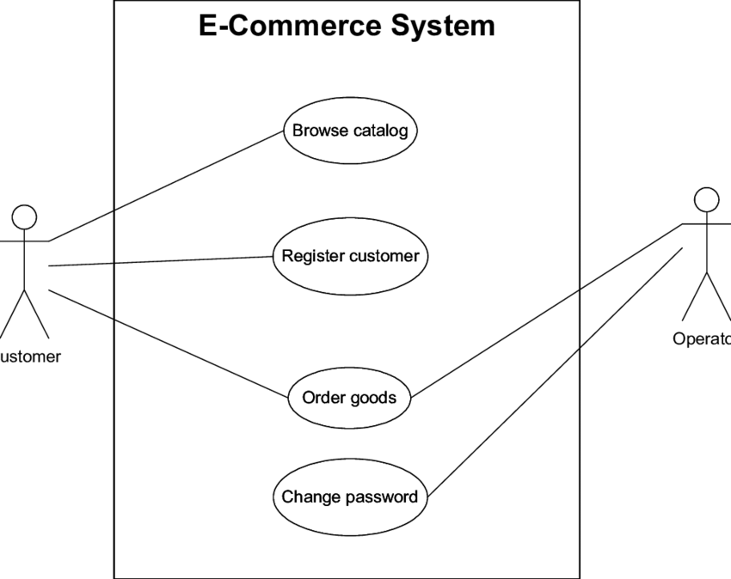
Top-Level Use Case Model - 1

Slide 6
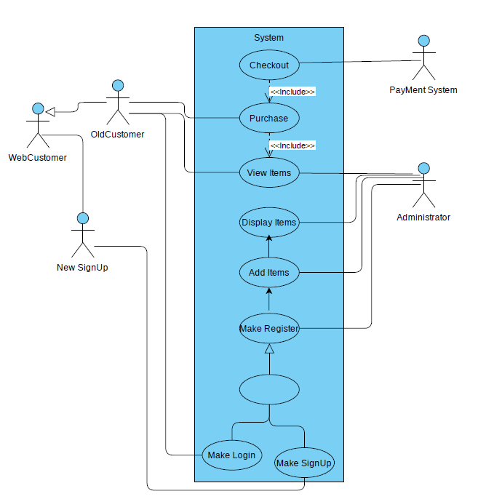
Top-Level Use Case Model - 2

Slide 7
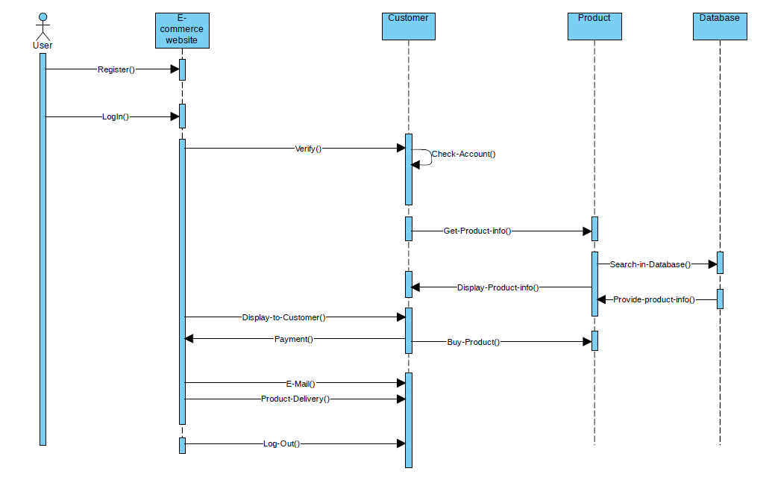
Sequence Diagram

Slide 8
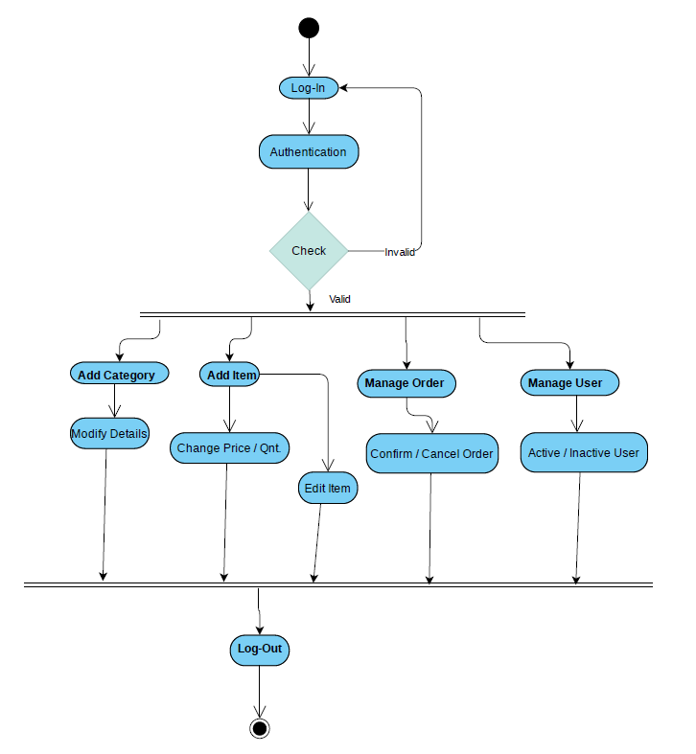
Activity Diagram

Slide 9
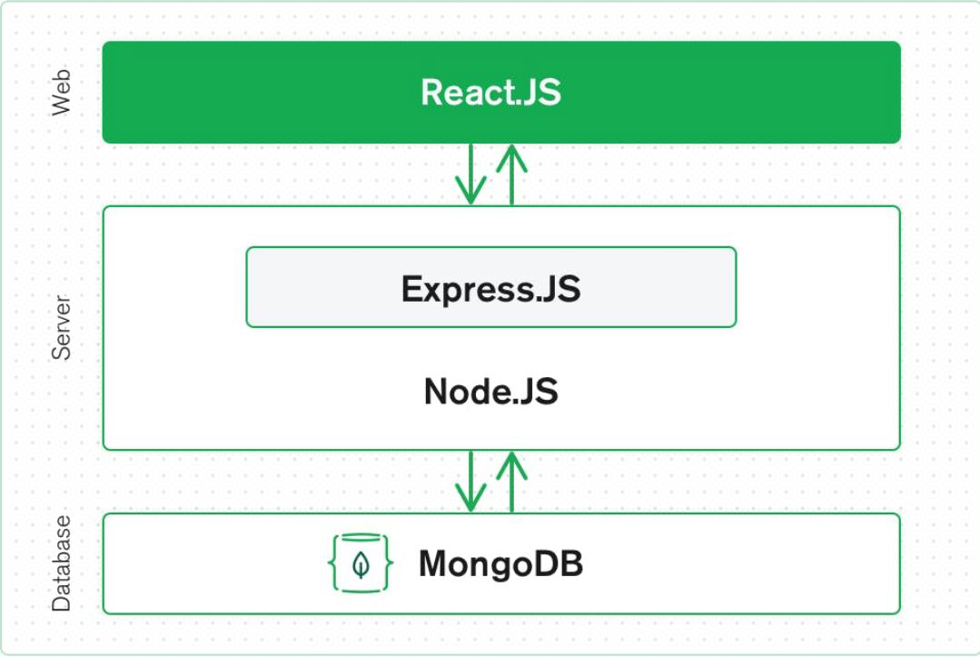
Application Architecture
MERN Stack: MERN Stack is a Javascript Stack that is used for easier and faster deployment of full-stack web applications.
MERN Stack comprises of 4 technologies namely: MongoDB, Express, React and Node.js.
The top-tier or client-side HTML based application interfaces are handled by React.js.
The server-side framework is handled by Express.js which runs inside Node.js server. It handles the HTTP requests and responses which are linked from frontend to database.
The data storage for our application needs a database which is in turn handled by the MongoDB, which directly stores the JSON documents from the frontend which were processed in Express.js server.

Slide 10
Tools and Technology
FrontEnd: HTML, CSS, React and Javascript
BackEnd: Node JS, Express and Postman
Database: MongoDB
Tools: Visual Studio code and Github

Slide 11
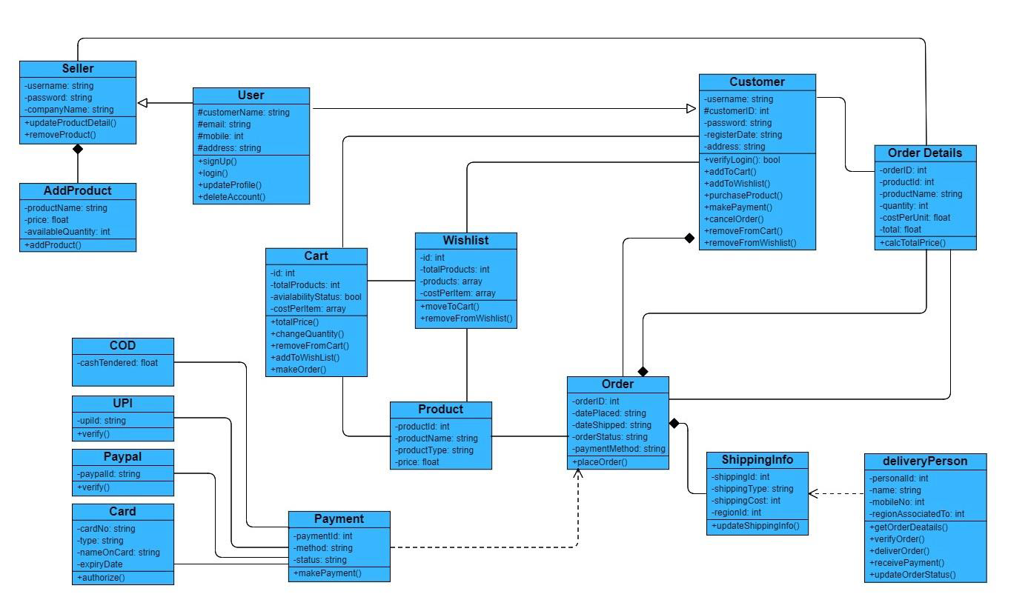
Detailed Class Diagram

Slide 12
Summary of implementation
We started the implementation with ER-diagrams representing our Data Models and various UML diagrams.
We then created to UI/UX to get a better perspective of our product.
Based on the data models, UML diagram and UI/UX, we started developing our product with MERN stack development technology.

Slide 13
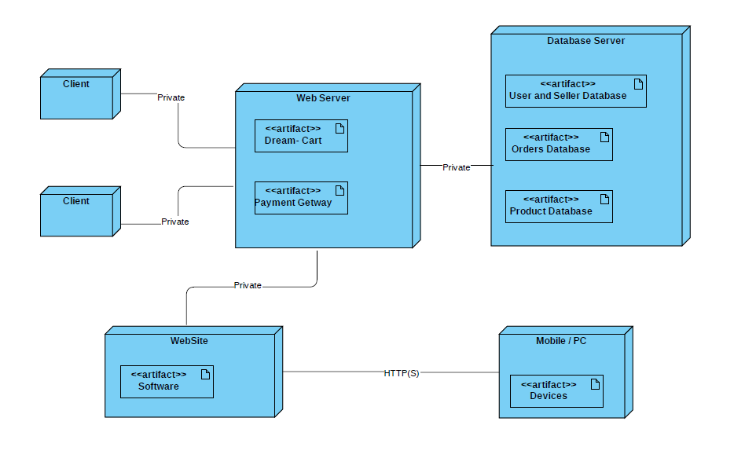
Deployment Diagram

Slide 14
Individual Contribution
Sr. No. | Name | Contribution
1 | Parth | Documentation, Design, Testing
2 | Fenil | Analysis, Documentation
3 | Jeel | Testing, Data Collection
4 | Ronak | Development, Documentation
5 | Het | Data Collection, Analysis
6 | Harsh | Design, Testing

Slide 15
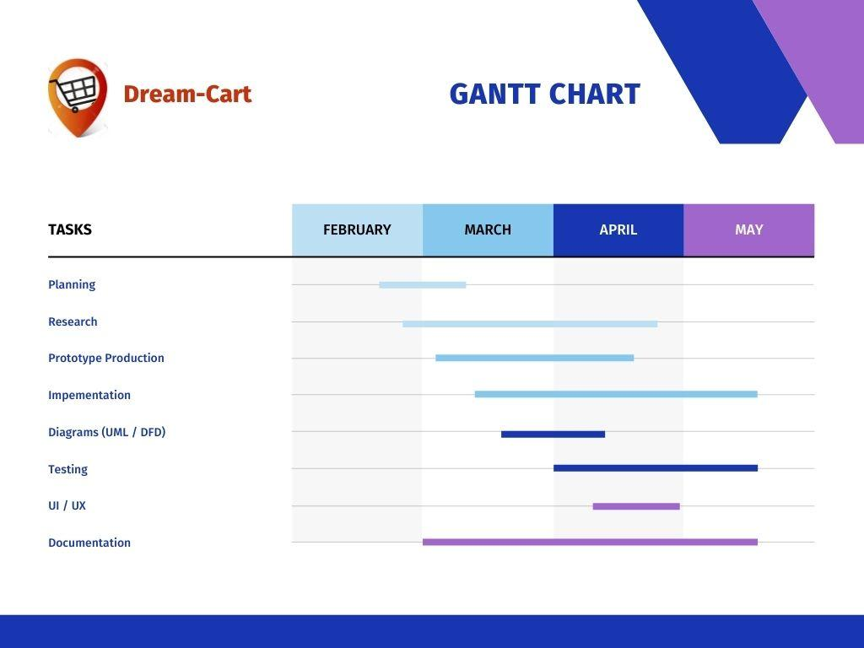
Gantt Chart

Slide 16
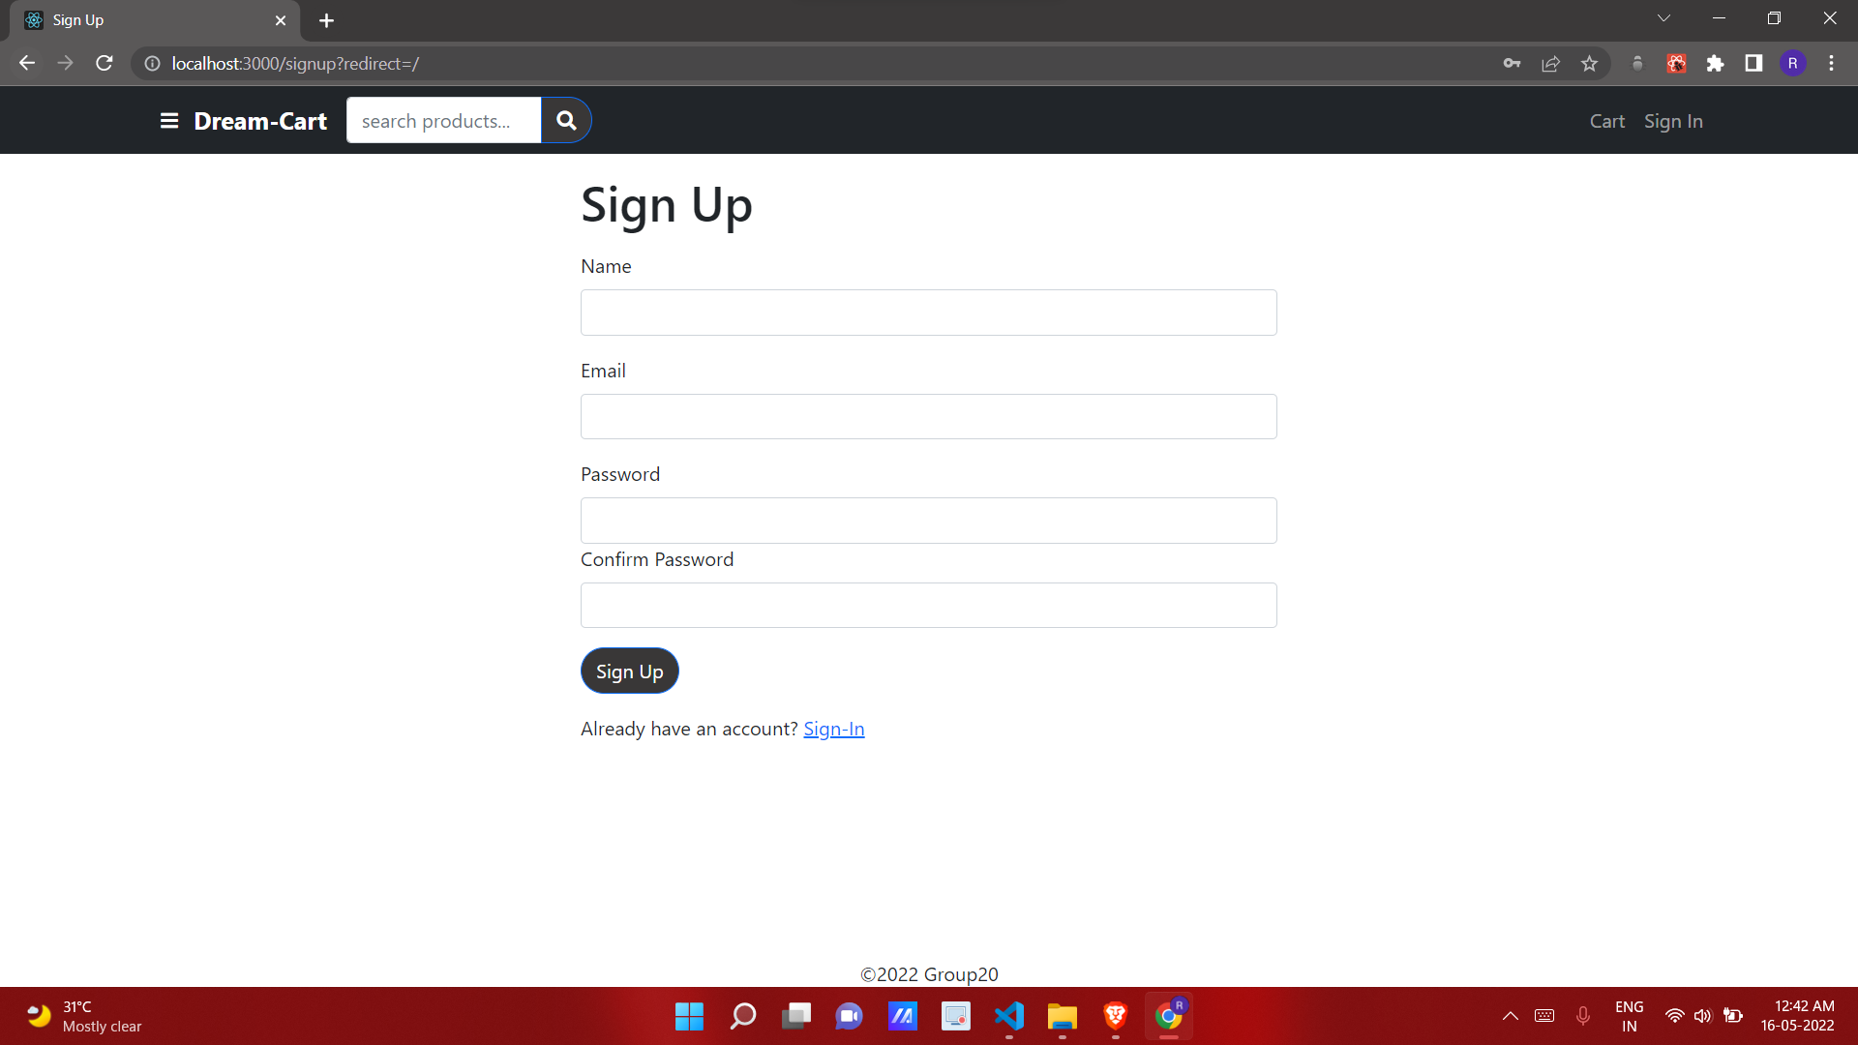
Application Navigation using UI/UX design
Signup Page

Slide 17
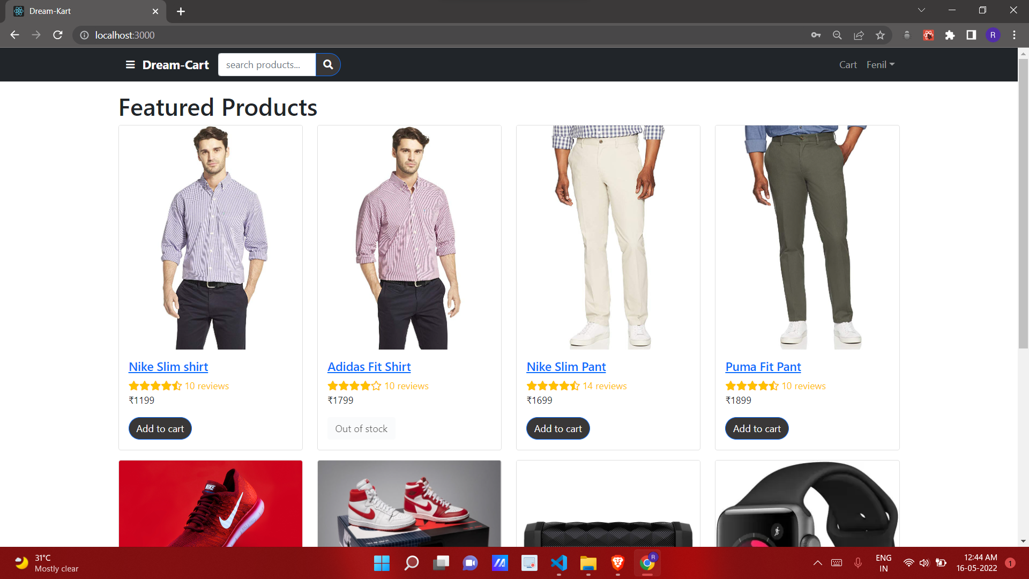
Home Page

Slide 18
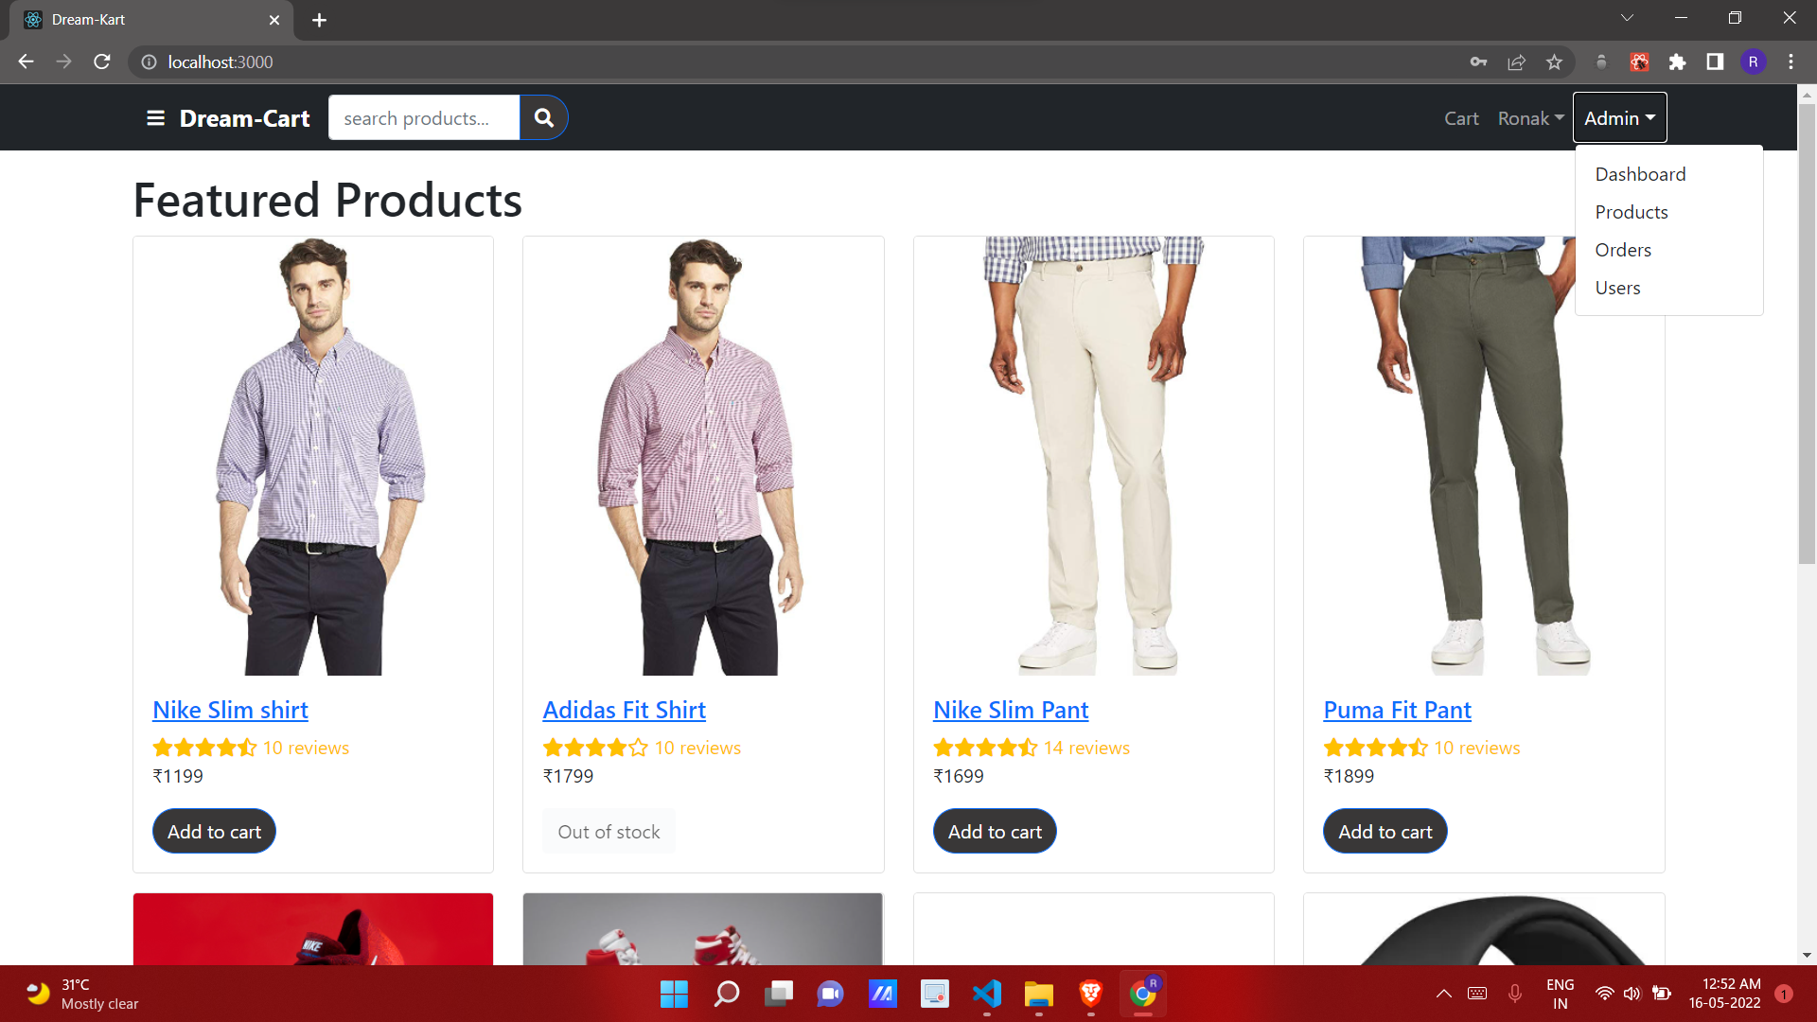
Admin HomePage

Slide 19
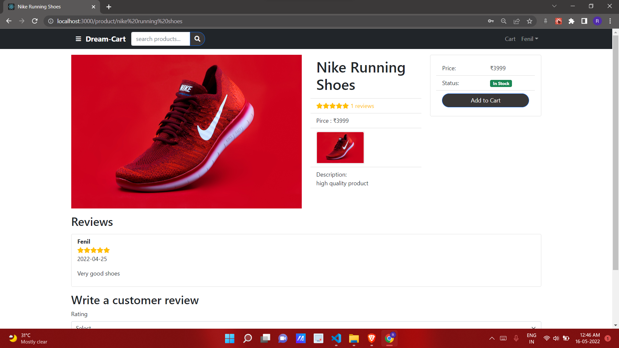
Product Detail Page

Slide 20
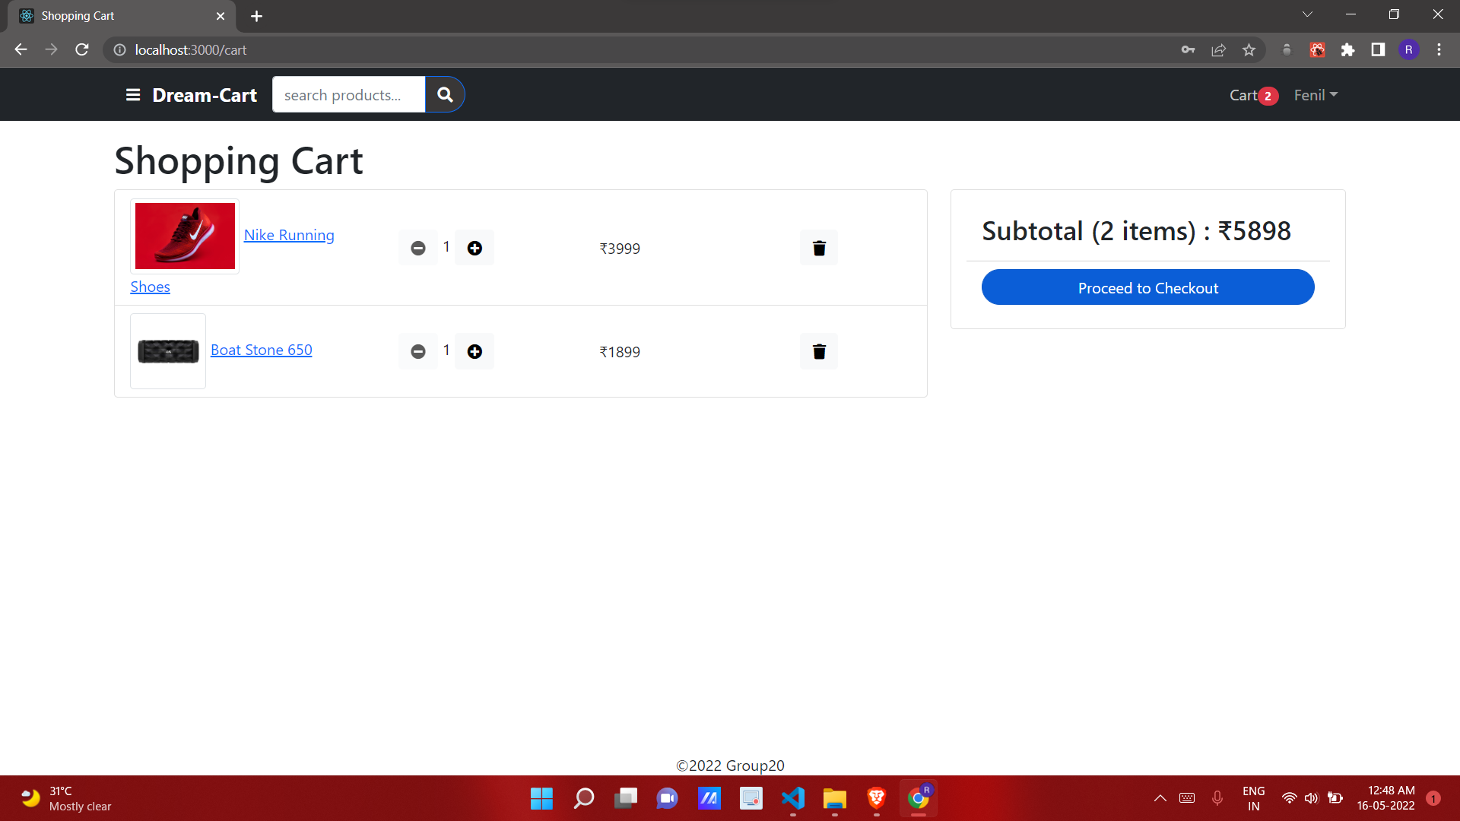
Shopping Cart

Slide 21
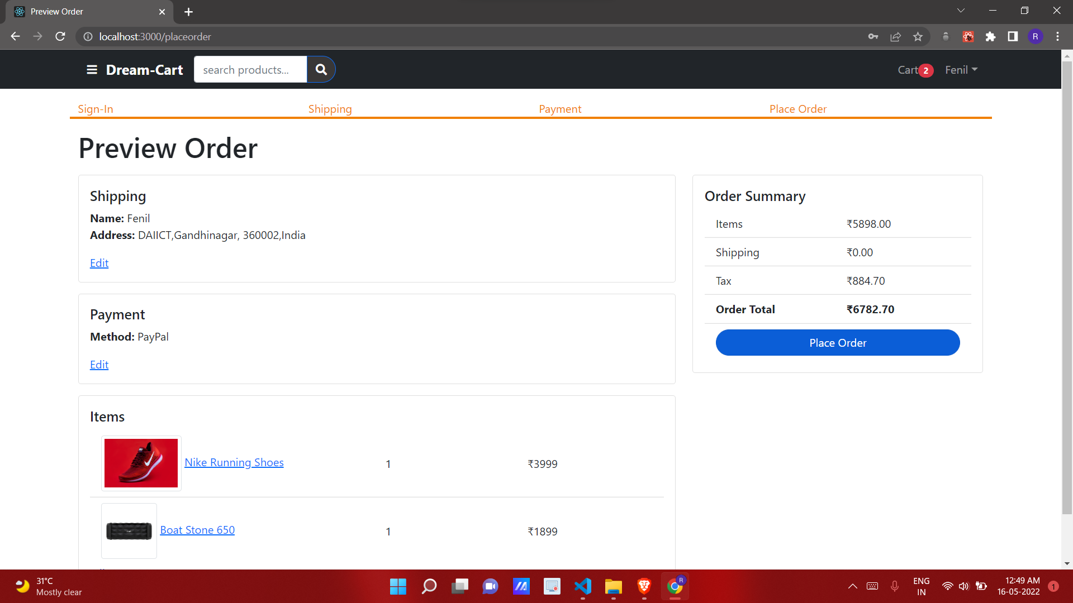
Place Order Page

Slide 22
Summary of Test Plan
Functionality | Related Use Case
Registration | Customer and Seller can register themselves on this site
Login | After successful login each user will be directed to its related homepage
Add to Cart | Customer user can add items to cart
Buy Product | Customer can make purchase on any of the items he/she wants to buy
Update Profile | User can update profile anytime

Slide 23
Github link for submissions
Source code
https://github.com/ParthR2302/SE_Project_E-Commerce
https://github.com/RJ07JB/Dream-Cart

